Slide 1






Spring Boot 3 & Beyond

Slide 2




Spring Boot 3
JDK 17 baseline
Jakarta EE 9 / 10 (Jakarta namespace)
Support for native images (AOT)
Observability (Micrometer)
Spring framework 6
Spring Boot 3.1
Docker Compose Module
Spring Boot 3.2
Virtual Threads (“Project Loom”)

Slide 3



Spring Boot 3.0

Slide 4



Baseline: JDK 17 LTS
Language: tekst blocks, switch expressions
Core libraries: collection factory methods, etc
Type system: records, sealed classes
Module system: module introspection, module path scanning
Preformance Improvements
Security Updates
Empowering the framework as well as applications

Slide 5




Baseline: Jakarta EE 9
A new namespace: Java EE8 → Jakarta EE 9/10
Servlet API 5.0: javax.servlet → jakarta.servlet
JPA 3.0 : javax.persistence → jakarta.persistence
Bean Validation 3.0 : javax.validation → jakarta.validation
Dependency Injection 2.0 : javax.inject → jakarta.inject
All further API evolution will also happen in jakarta namespace

Slide 6
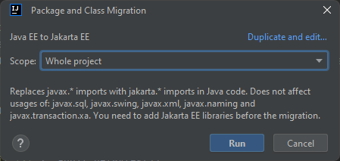
Migrating with the help of IDE
With inteeliJ you can migrate your project fast:
Go to refactor → Migrate packages and classes -> Java EE to Jakarta EE

Slide 7

Support for native images (AOT)
With spring Boot 3 application can now be converted into GraalVM native images which can provide significant memory and startup-up performance improvements.

Slide 8




Slide 9
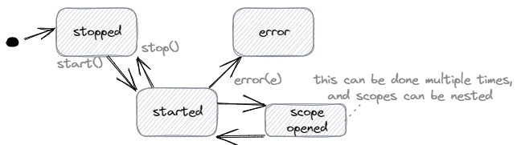
Observability (Micrometer)
Observability is the ability to measure the internal state of a system only by its external outputs (logs, metrics, and traces).
As we know, Micrometer is the metrics and tracing collection façade of a spring boot application that uses Actuator.
Spring boot offers us the ObservationRegistry interface that can be implemented to create observation which provides a spingle API for both metrics and traces. Observations have a lifecycle that’s as simple as this diagram shows:

Slide 11
Docker compose
Typically, we’d run docker-compose up to start and docker-compose down to stop our containers based on a docker-compose.yml. We can now delegate those Docker Compose commands to Spring Boot 3. While the Spring Boot application starts or stops, it’ll also manage our containers.
Furthermore, it has in-built management for multiple services, such as SQL databases, MongoDB, Cassandra, etc. Therefore, we might not need configuration classes or properties to duplicate in our application resource file.

Slide 13
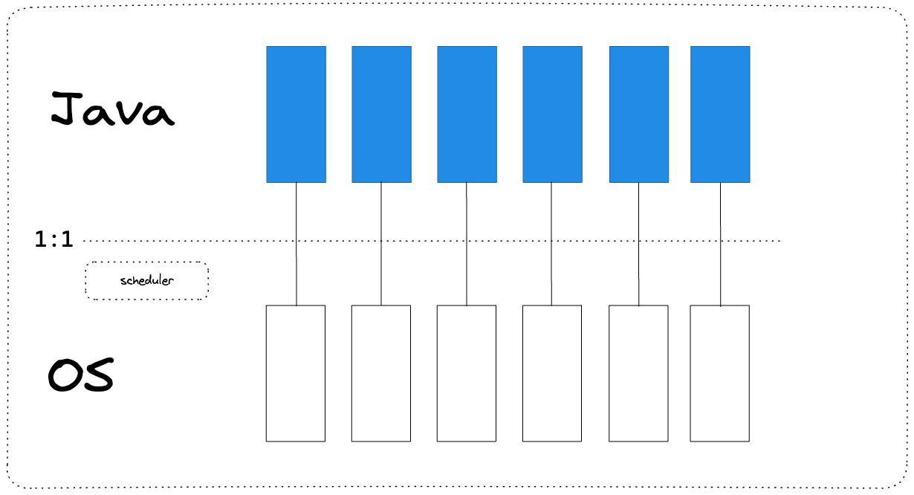
Virtual threads (“project loom” JDK 21)
In Java, each statement inside of a method executes in a thread. Java is Multi-threaded which means more than one thread can be executing a given set of instructions at once. Threads are fundamental to concurrent programming and allow a Java program to perform multiple tasks or operations concurrently, making efficient use of available resources, such as CPU cores.
In Java, a thread (java.lang.Thread) serves as a thin wrapper around the operating system thread, commonly known as Platform Threads. The operating system thread is a limited resource that relies on system resources. One major drawback of Platform Threads, in addition to their ubiquity, is their high resource consumption in terms of memory and processing time.

Slide 14
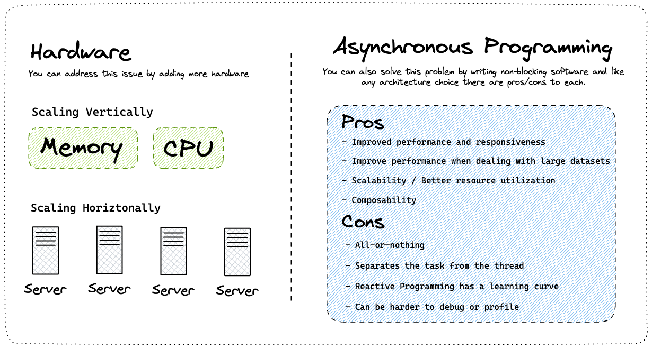
Virtual threads (“project loom” JDK 21)
Now imagine you need to perform a blocking operation such as talking to a database or communicating with a service over HTTP. These operations are consider blocking because the thread responsible for handling this operation needs to wait for the operation to complete.
Before the introduction of virtual threads, there were two options available for addressing scalability issues in concurrent programming in Java. One option was to add more hardware by scaling horizontally or vertically. Another option was to use asynchronous programming, which, like any architectural choice, has its own advantages and disadvantages.

Slide 15
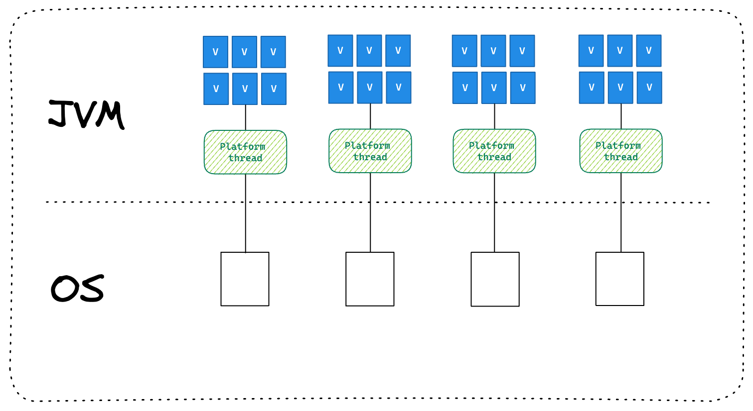
Virtual threads (“project loom” JDK 21)
Virtual Threads were introduced in JDK 21 as a solution to the challenges of asynchronous programming. These lightweight threads do not block platform threads, making them highly efficient. In fact, you can spawn millions of Virtual Threads without needing to worry about thread pooling. This allows us to write imperative blocking code without significant concerns about scalability. Of course there are still Platform Threads which are a finite resource so how does this work under the hood? When a virtual thread is attached to a platform and needs to perform a blocking task it is unmounted from the platform thread and moved to the heap. When the blocking operation has completed it is taken from the heap and moved to a waiting list for the platform thread it was initially mounted on.
This is really just a high level introduction to Virtual Threads in JDK 21.

Slide 16
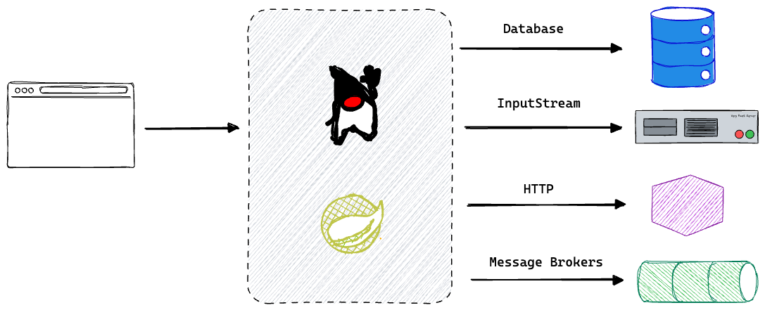
Virtual threads (“project loom” JDK 21)
Now that you have an understanding of concurrency in Java and the problem that Virtual Threads are trying to solve, let's discuss it in the context of Spring Boot. If you are building Spring MVC applications that involve blocking operations, such as database communication, writing to an Input Stream, or interacting with an HTTP service, then your application is an ideal candidate to benefit from Virtual Threads.

Slide 18



THANK YOU!

